Slide 1
Women SAFETY sentiment Analysis Based
On Twitter Data Using ML

Slide 2

BACHOLER OF TECHNOLOGY: COMPUTER SCIENCE DEPARTMENT.
SUBMITTED BY:
-AYUSH KUMAR (1903700100003) AND -KM MINAKSHI(2003700109003)
BATCH(2019-2023)
UNDER THE SUPERVISION OF: MR.NAVEEN KUMAR
SHANTI INSTITUTE OF TECHNOLOGY ,KURALI (MEERUT)

Slide 3
S.NO. TOPICS
ABSTRACT
INTRODUCTION
RELATED WORK
METHODOLOGY
ER DIAGRAM

Slide 4
USED OBJECTS -
- PYTHON (Programming language)
- Sentiment Analysis
- Machine learning algorithms (NB, SVM)
Bag of words algorithm
Windows operating system (Windows 10-11)
RAM required ( Min 4 GB)

Slide 5
ABSTRACT:
Women and girls have been experiencing a lot of violence and harassment in public places in various cities starting from stalking and leading to abuse harassment or abuse assault.
In this project we mainly focus on the role of social media which can be used to promote the safety of women in India, given the special reference to the participation of many social media websites or applications such as Twitter, Facebook and Instagram platforms.

Slide 6
Collection such data from twitter help us to analyze the safety levels in the various Indian cities. Applying various machine learning algorithm on tweets and performing analysis on them into natural negative and positive can help us improve the situation.

Slide 7
INTRODUCTION:
Twitter , in this modern era has a ultimate social network consisting over hundred million users and generate over five hundred million messages known as ‘Tweets’ every day.
On the twitter, users will share their opinions and perspective in the tweets section. This tweet can only contain 140 characters.
From the tweets we extract the users sentiment by using sentiment analysis.
By the sentimental analysis we determine the comments and find the conclusion in the three forms: -Negative ,Positive and Neutral.

Slide 8
RELATED WORK:
Sentiment Analysis (SA): It is a subject of study that investigates people’s sentiments, views, assessments, appraisals, attitudes and emotions.
Machine learning and Lexicon based learning and Hybrid learning are some of the approaches of sentimental analysis.
Machine-learning based approach:-This technique mainly involves the usage of various algorithms such as Naïve Bayes, support vector machine.

Slide 9
Lexicon-based approach:-It is a also referred to as a Rule-based system. this approach follows semantic analysis i.e., makes use of a lexicon(i.e., a record of positive and negative words).
Hybrid system:- This techniques involves combining the previous two techniques to produce an improved accuracy and results by overcoming the limitations of the individual techniques.

Slide 10
OUR METHODOLOGY:
FLOWCHART-
DATASET
PRE-PROCESSING
FEATURE EXTRACTION
CLASSIFIER(NB , SVM)
OUTPUT

Slide 11
I . Data Collection: The data is gathered from the twitter using API. Application program interface (API) is utilized to gather the information. Twitter website is a source which consists of users tweets.
ii. Data Pre-Processing: In Data Pre-processing removing noisy, unrelated data, inconsistent and incomplete data from the dataset. Generally, in twitter we have to remove URLs, special characters, retweets, hash tags.

Slide 12
iii. Feature Extraction:
Algorithm- Bag of words:
In this work, we used Bag of Words to extract features from text documents. After extraction, these features used for training machine learning algorithms. Bag of words features containing term frequencies of each word in each document, i.e. the number of occurrence and not sequence or order of words matters. This can be done by Count Vectorizer method in python.

Slide 13
iv. Classification/Output:
Machine learning approach:
To measure the sentiment of the tweets in terms of Positive and Negative, Bar graphs can be used. Similarly, to measure in terms of likes, dislikes, average length of tweet for a certain period, Time series can be used. To obtain the initial source of the tweet.

Slide 14
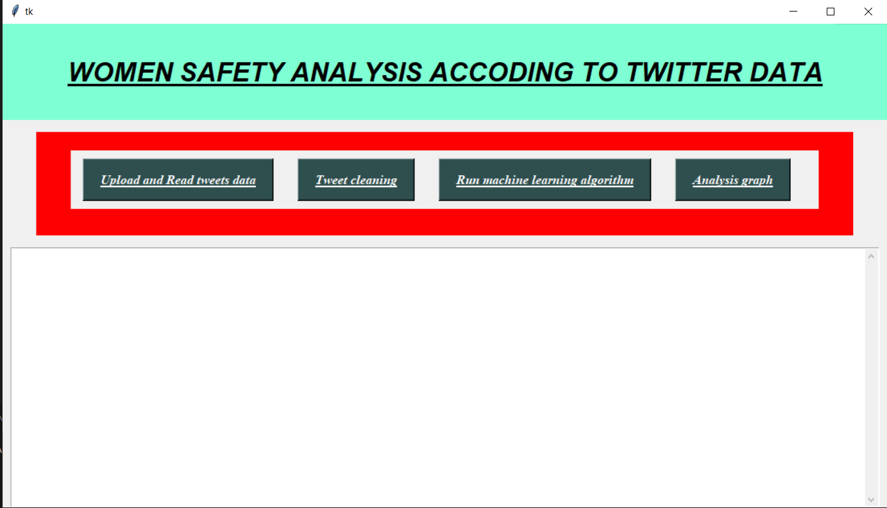
#1. HOME SCREEN-

Slide 15
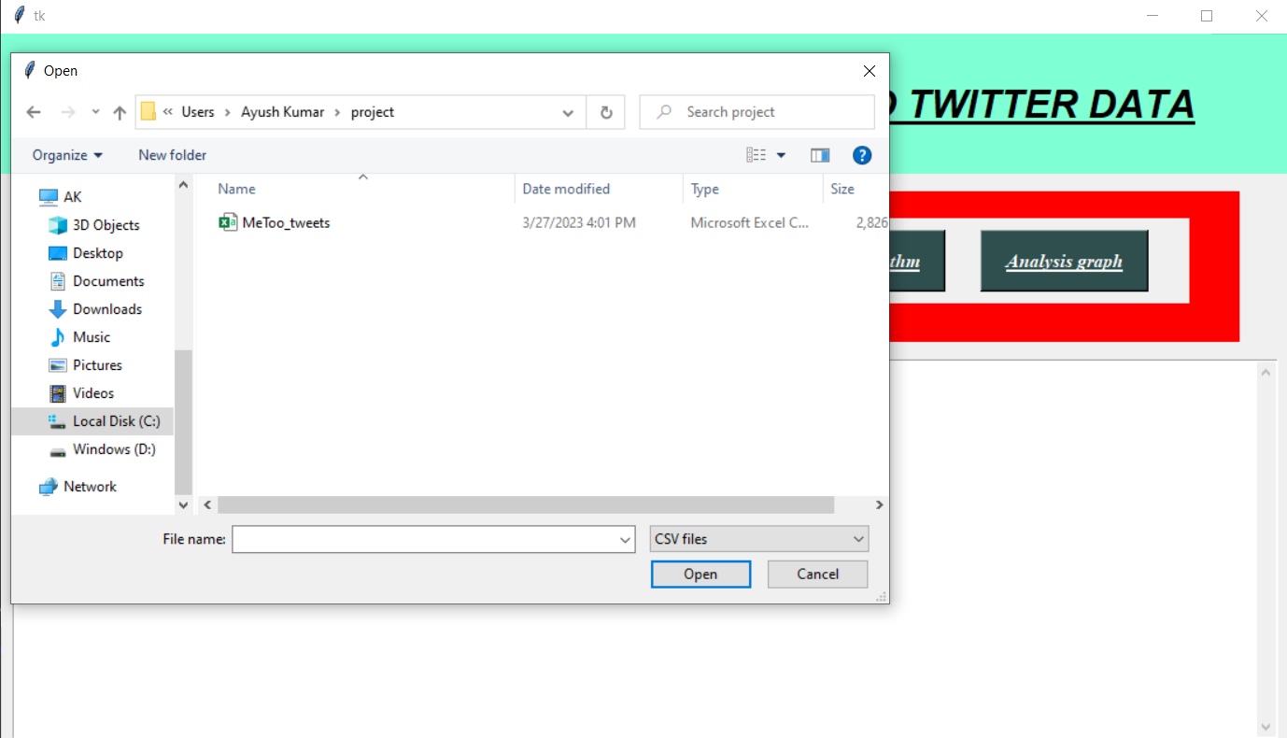
#2. Selecting the Data Set for Process:

Slide 16
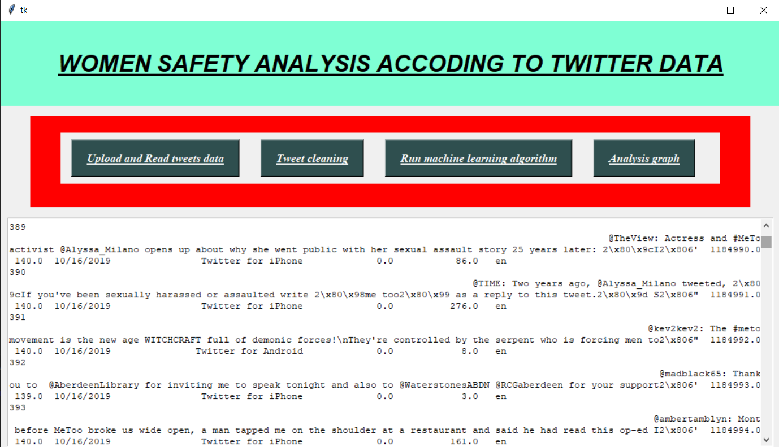
#3. Upload and read data

Slide 17
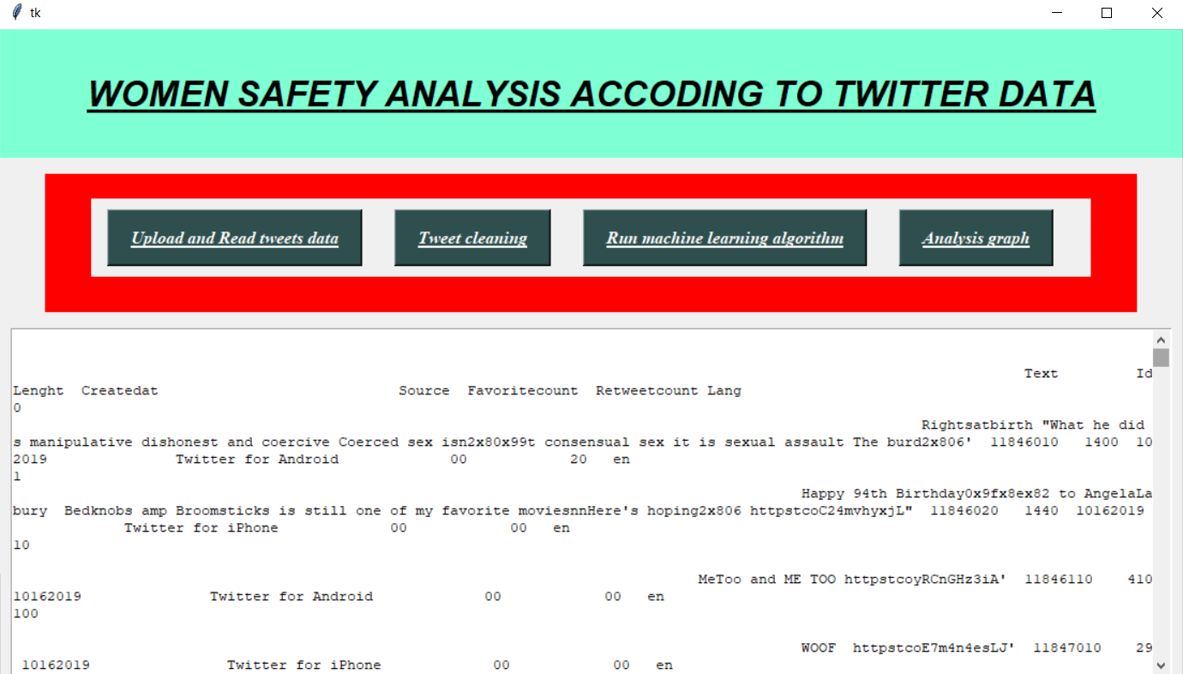
#4. tweets cleaning

Slide 18
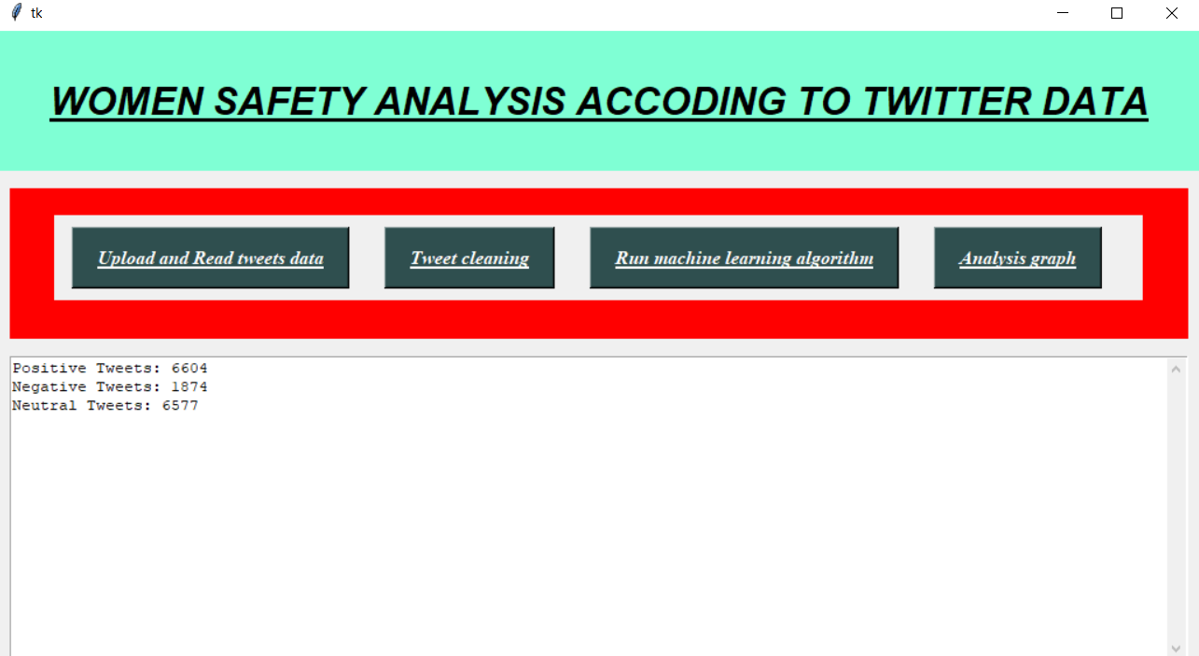
#5. run machine learning algorithm

Slide 19
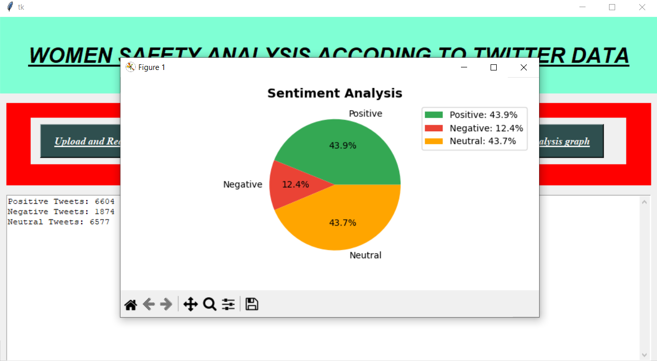
#6.result/output

Slide 20
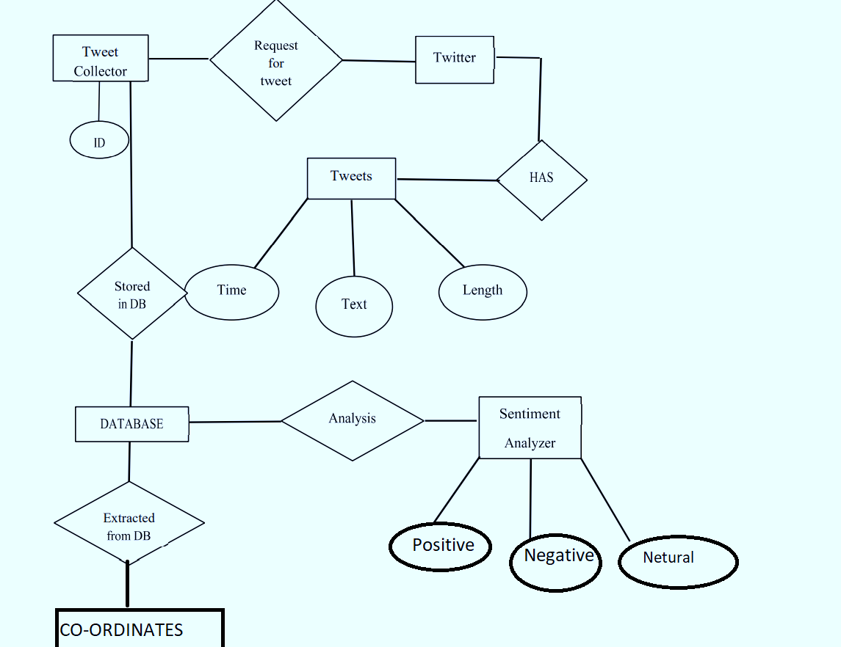
ER-DIAGRAM

Slide 21
----------THANK YOU---------
BY____(CSE STUDENTS)
- KM MINAKSHI
- AYUSH KUMAR

